Slide 1

INTERACTIVE ADVERTISING CAMPAIGN IN THE MALL:
FACE RECOGNITION AND LANDMARKS DETECTION
KSENIYA KUDZELICH
HTTPS://GITHUB.COM/KKUDZELICH/FACIAL-RECOGNITION-AND-LANDMARKS-DETECTION

Slide 2
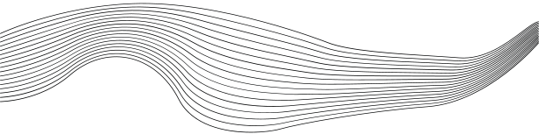
CONTENT
01
PROJECT DESCRIPTION AND HOW IT WORKS
02
DATA OVERVIEW
03
CLUSTER ANALYSIS
04
FACE RECOGNITION MODEL
05
FACIAL LANDMARKS DETECTION MODEL
06
CONCLUSION

Slide 3
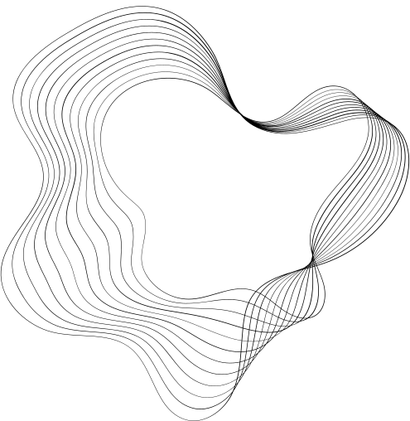
PROJECT DESCRIPTION
Project: Interactive advertising campaign in the mall to increase visitor engagement and increase sales.
Client: An advertiser interested in innovative methods of attracting customers.
Task: Create a system that identifies loyal customers and adapts advertising content in real time based on their reactions and emotions.
SOLUTION
Face classification model: Identification of regular customers to offer personalized promotions and discounts.
Key points detection model: Analysis of visitors' reactions to commercials and interactive stands.

Slide 4
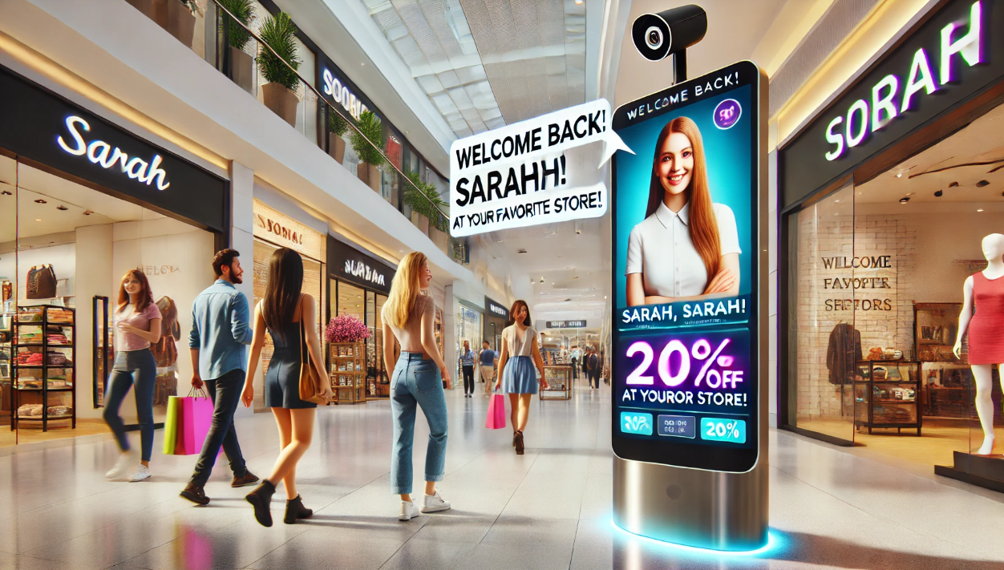
HOW IT WORKS
Cameras identify regular customers and offer them personalized discounts and offers.
Interactive stands track visitors' reactions to ads and adapt content based on their emotions.
If interest is noticed, it offers additional information or a discount.
The advertiser receives information about the effectiveness of the campaign to optimize advertising strategies.

Slide 5
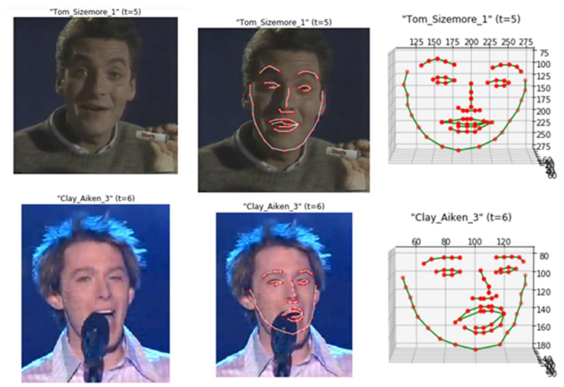
DATA OVERVIEW
Short videos of 828 unique individuals from YouTube
Total number of frames is 260,399
Each frame contains:
jpeg colors
2D landmark coordinates
3D landmark coordinates

Slide 6
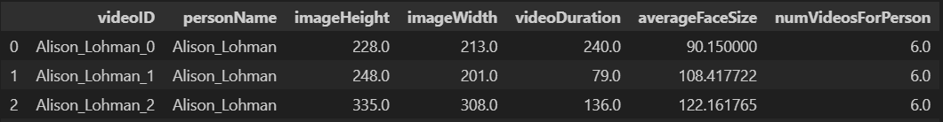
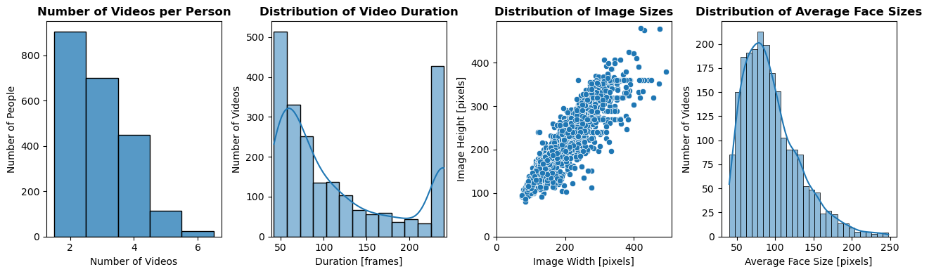
Average number of videos per person - 3
Average video duration - 118 frames
Images and faces of different sizes

Slide 7
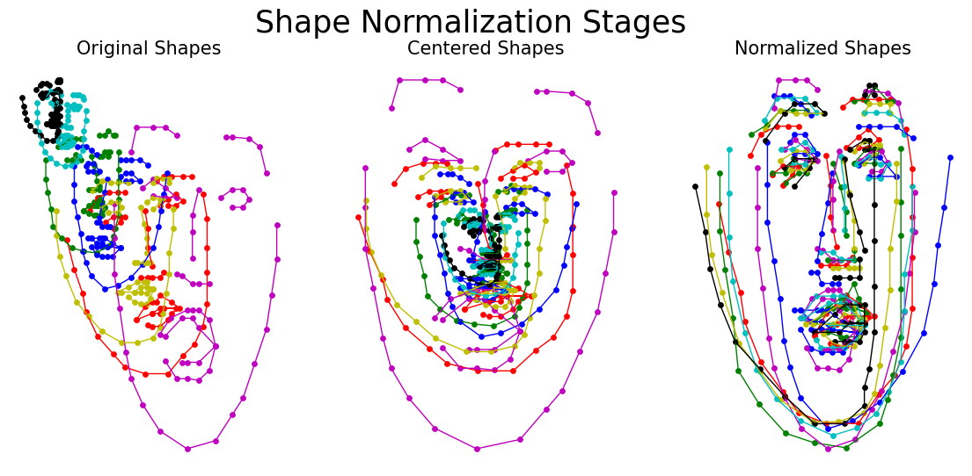
LANDMARKS NORMALIZATION

Slide 8
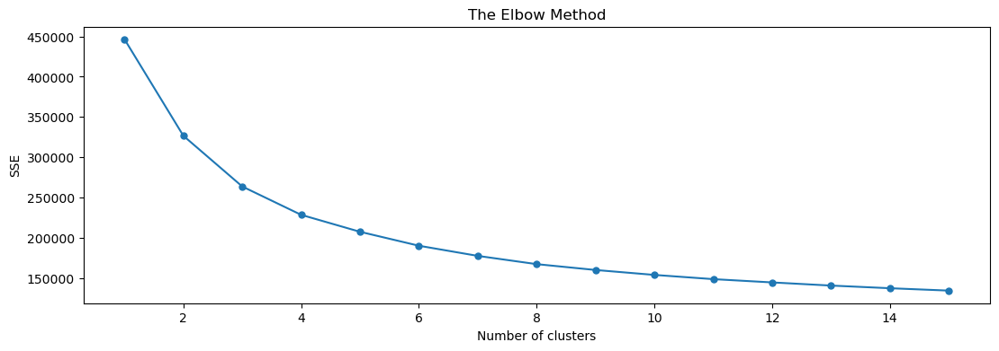
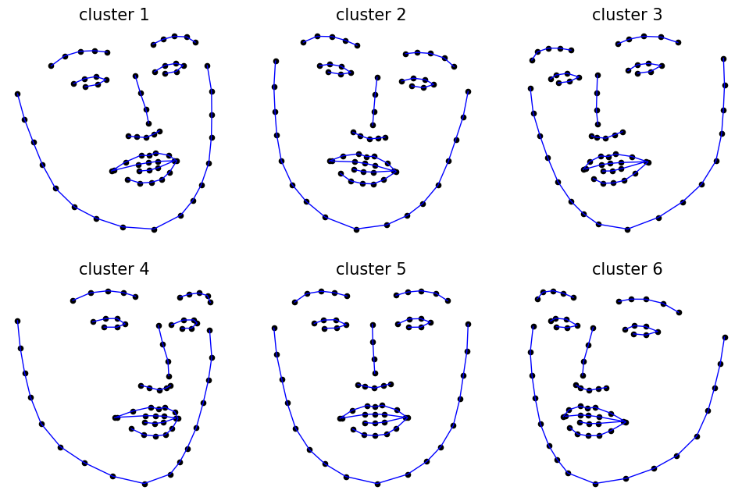
CLUSTER ANALYSIS
There is no obvious number of clusters.
But let's say somewhere around 6.
This way we can cluster people into groups with certain facial expressions or looking into specific directions.

Slide 9
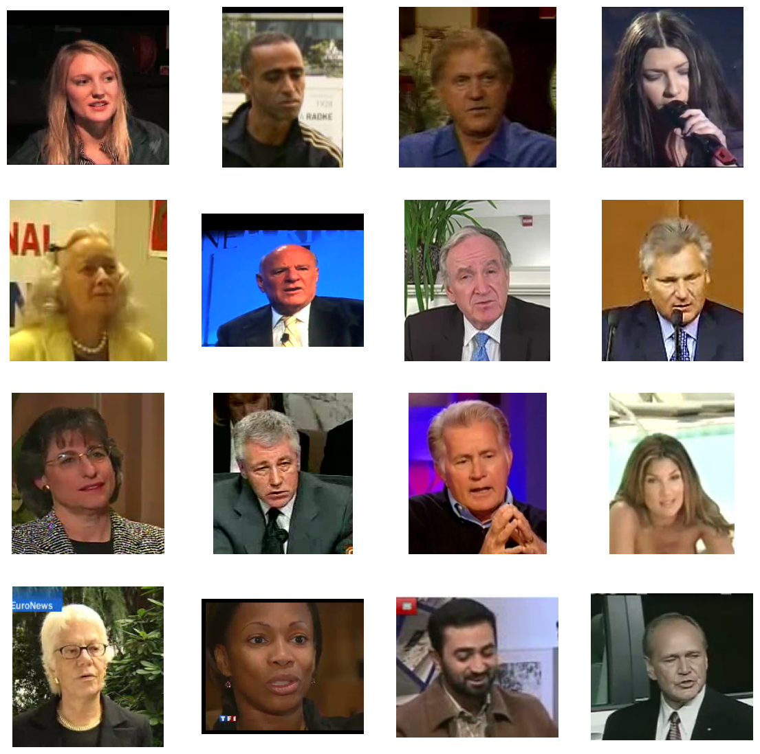
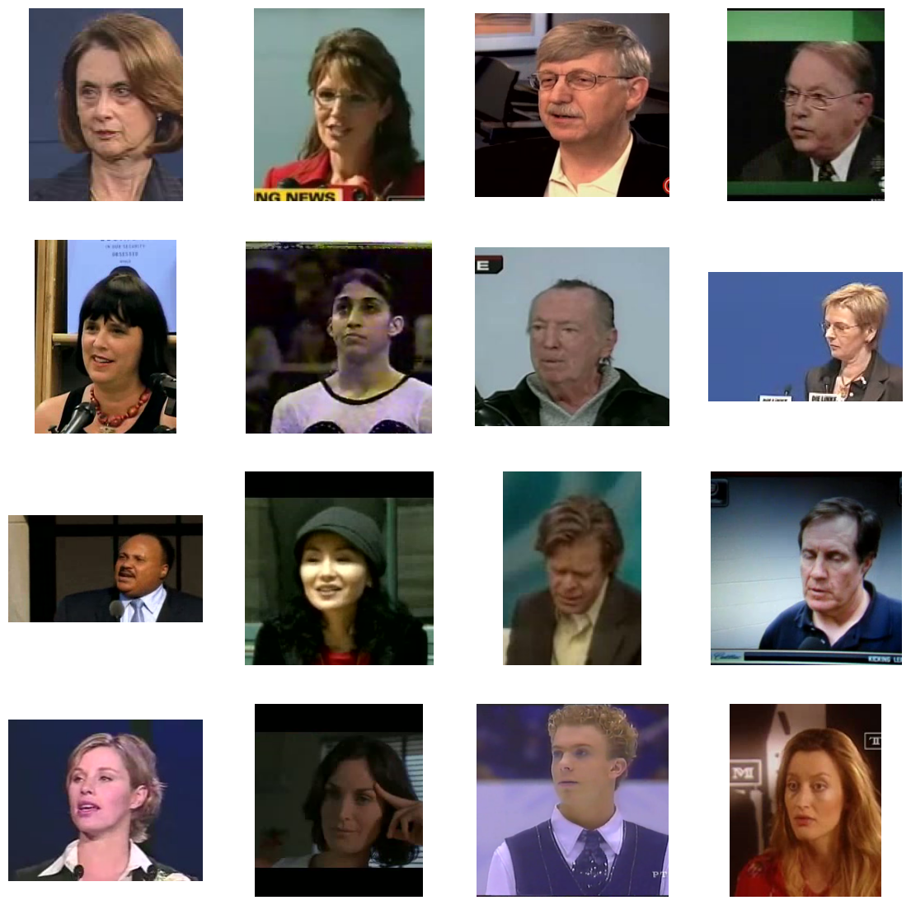
Cluster 1 - Crooked mouth and Look to the Right
Cluster 6 - Look left

Slide 10
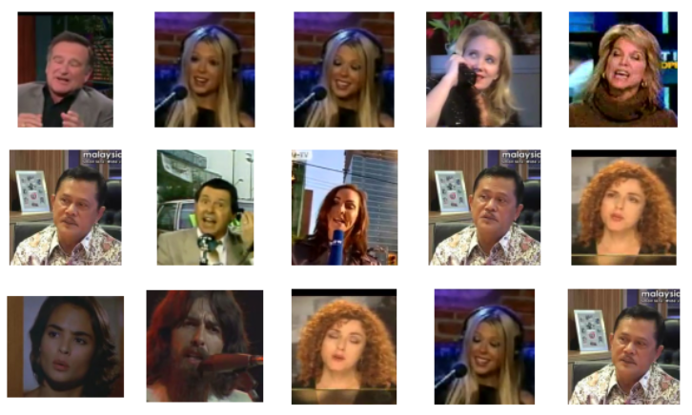
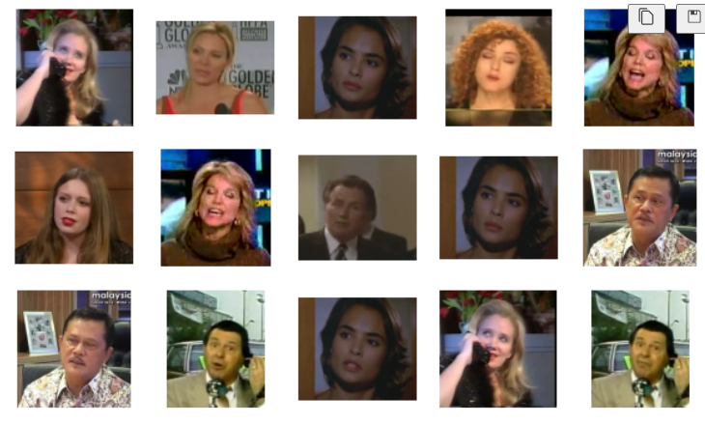
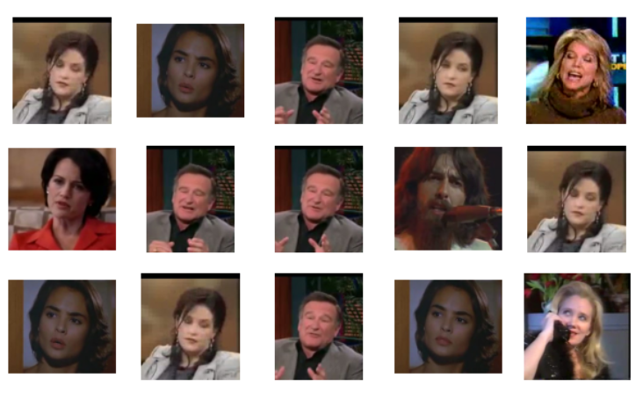
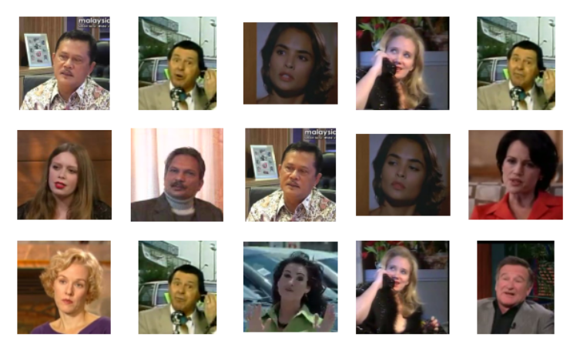
But can we group them by the same person?
What if we generate a model for 828 clusters?

Slide 11

FACE RECOGNITION MODEL USING LANDMARKS AS FEATURES
Model | F1-score
Gaussian Naive Bayes (GNB) | 0.12008
Logistic Regression | 0.20715
Decision Tree | 0.48892
Random Forest | 0.68603
K Nearest Neighbor (KNN) | 0.92522
KNN advantages:
Simplicity
Interpretability
Good results with enough data
KNN disadvantages:
May not work well with high-dimensional data
Sensitivity to unbalanced data

Slide 12
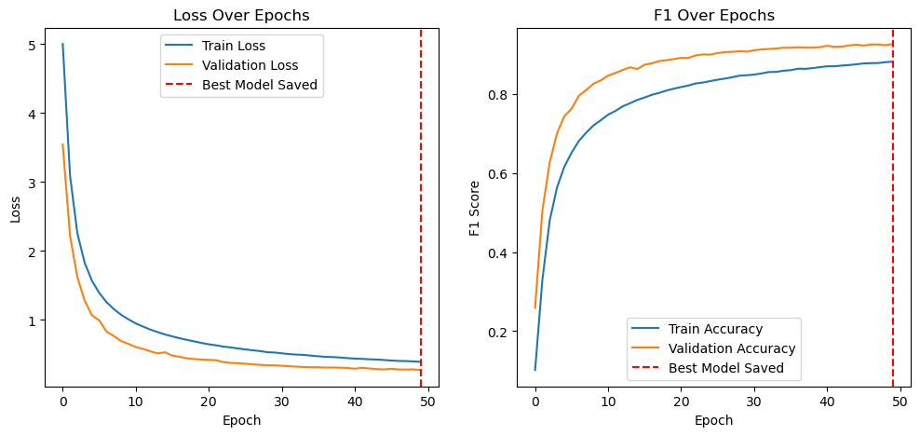
FEED FORWARD NEURAL NETWORK (2D)
FNN advantages:
Can find complex nonlinear dependencies
Works well with high-dimensional data
Flexibility and adaptability
Scalability
FNN disadvantages:
Requirements for computing resources
Careful setting of hyperparameters and architecture
F1-score 0.92755

Slide 13
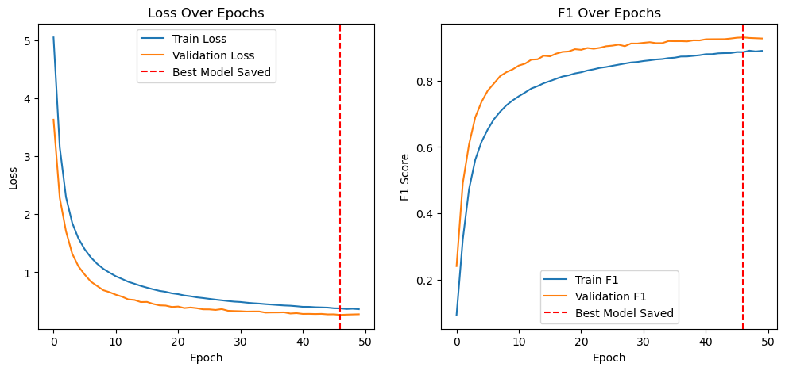
FEED FORWARD NEURAL NETWORK (3D)
F1-score 0.92756

Slide 14
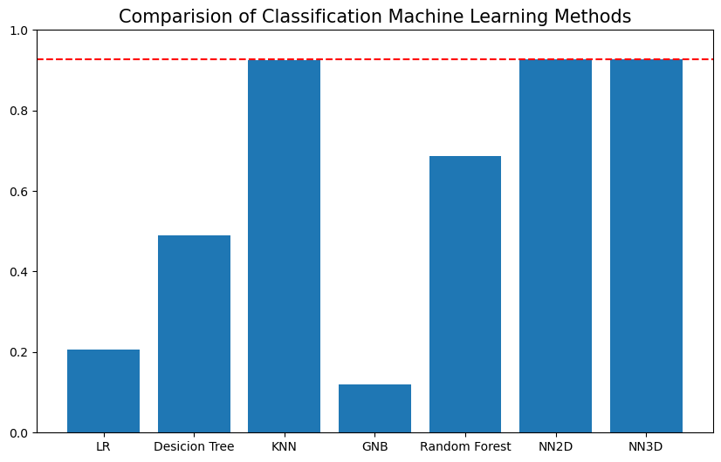
CONCLUSION ABOUT FACE RECOGNITION MODEL

Slide 15
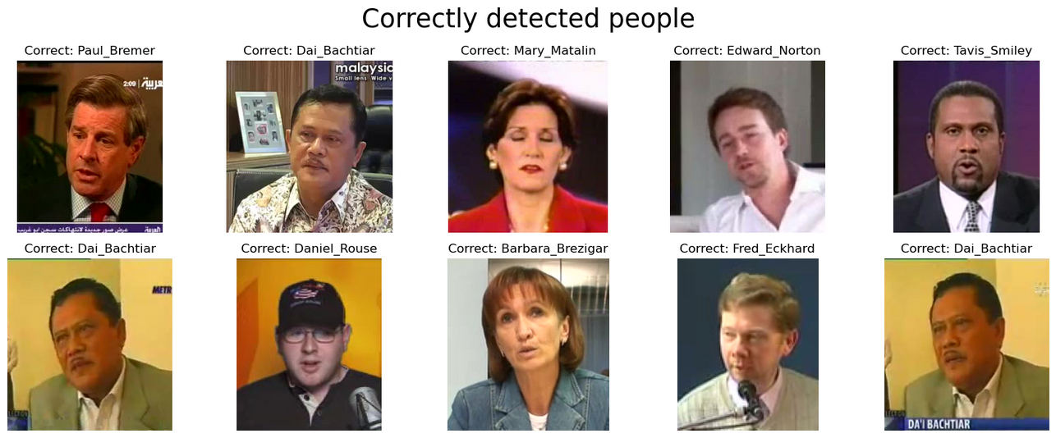
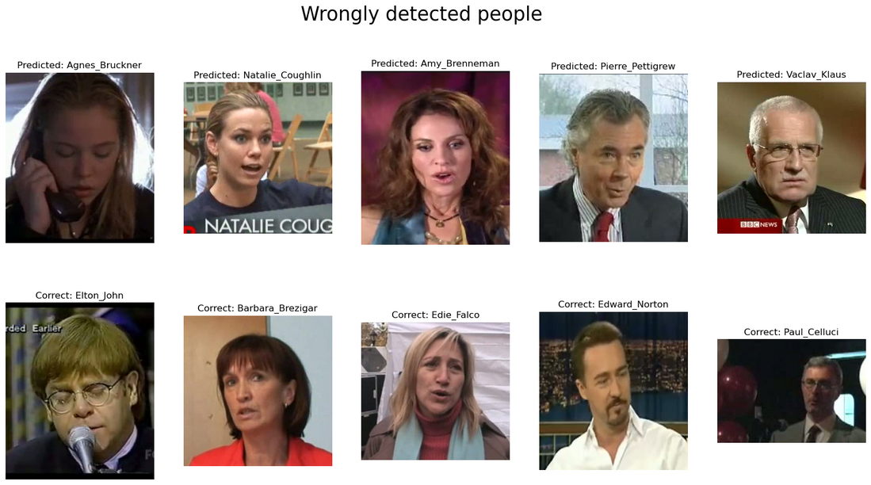
Most people are recognized correctly
EXAMPLES OF CLASSIFICATION
There are some people who have a little less data. And also there are people with similar features.
As an option for improvement, we can add more data for them.

Slide 16
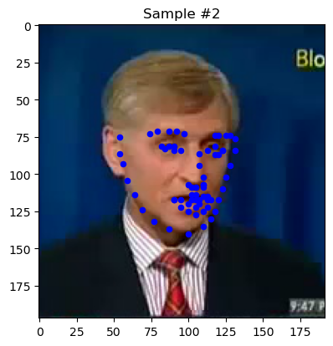
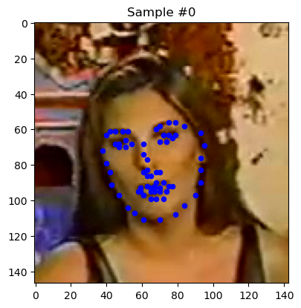
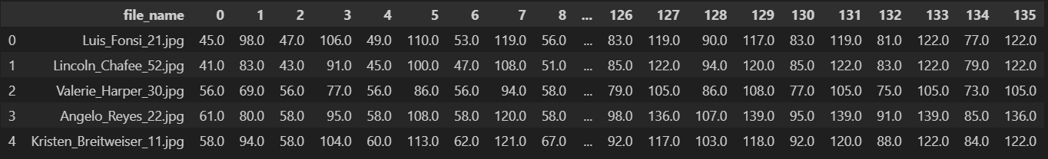
DATA OVERVIEW
Data has been partially extracted from the same YouTube Faces Dataset.
These videos have been turned into sets of image frames. Each frame contains one face and the associated keypoints.

Slide 17
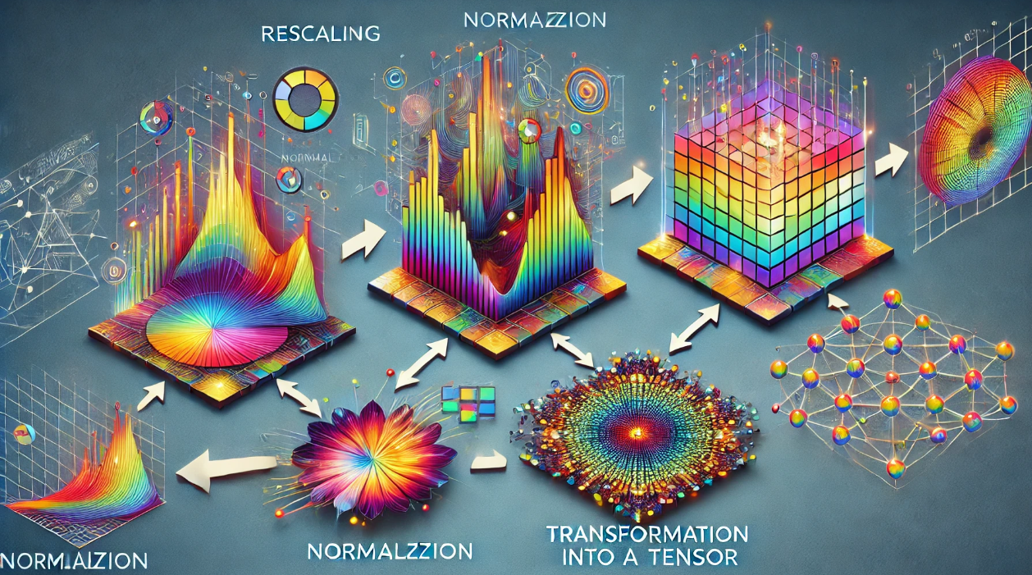
CUSTOM TRANSFORMATIONS
Rescale
ToTensor
rescale images to (224,224)
convert ndarrays in sample to Tensors
Normalize
RandomRotation
AddNoise
normalize images and keypoints to [0,1]
randomly rotate the image between -90 and +90 degrees
add random noise to the image

Slide 18
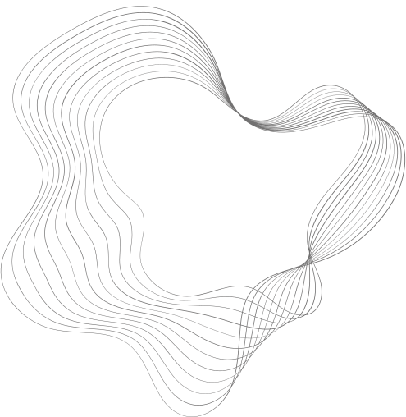
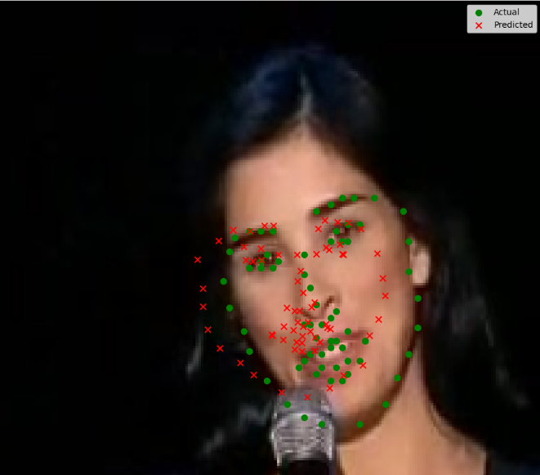
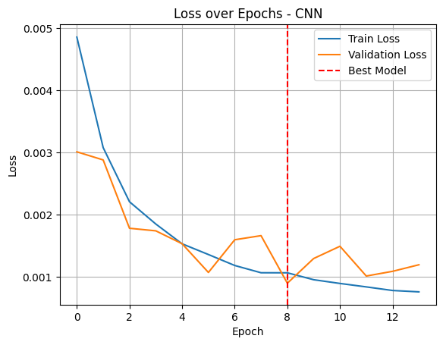
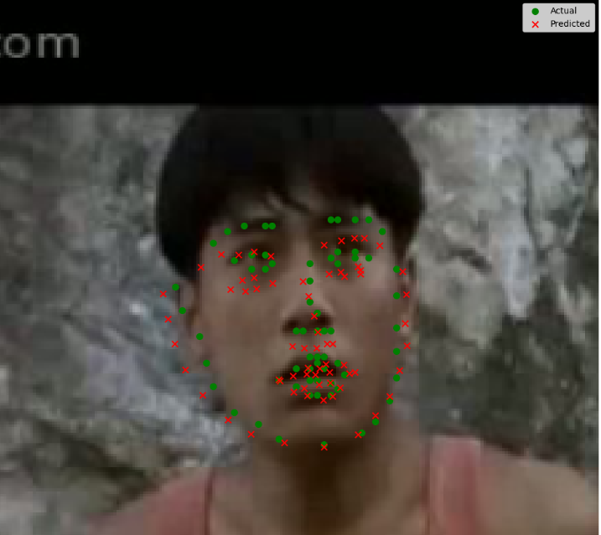
CNN FOR LANDMARKS DETECTION

Slide 19

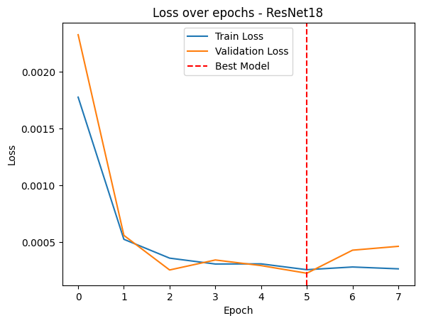
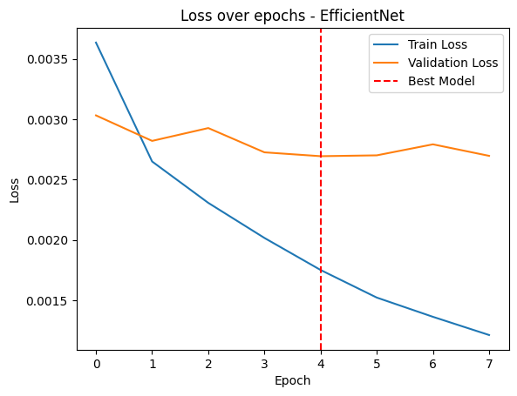
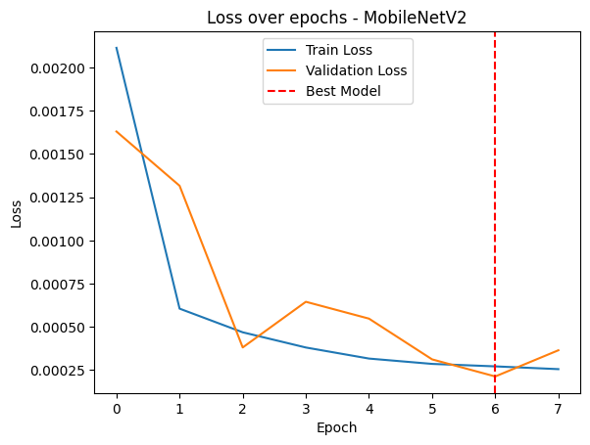
PRETRAINED MODELS
01
02
03
RESNET
EFFICIENTNET
MOBILENET

Slide 20

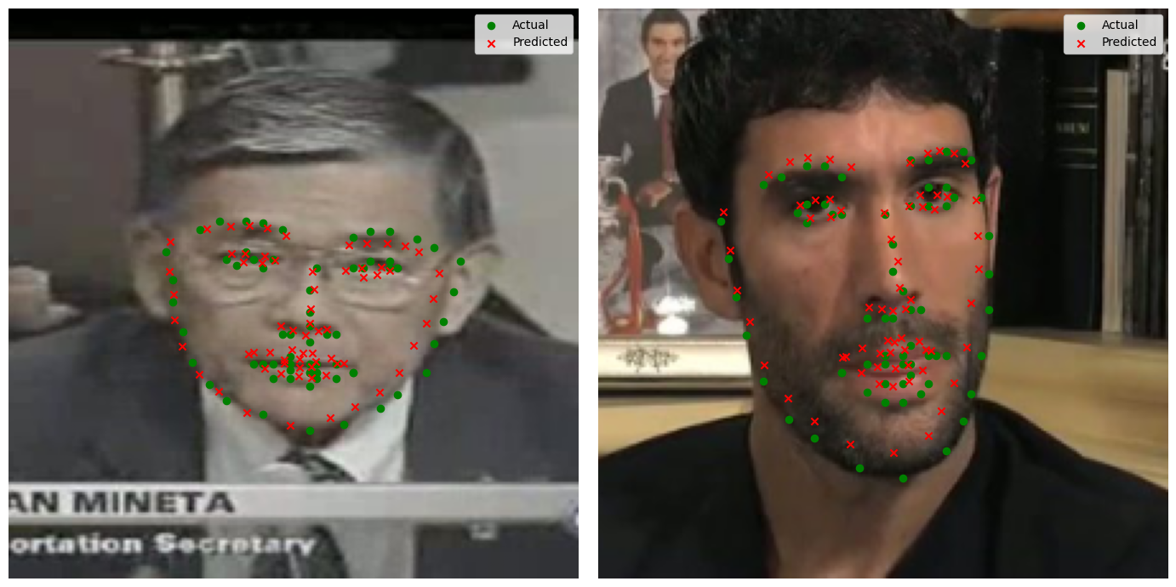
Model | MSE Loss
EfficientNet-b0 | 0.0019
my CNN | 0.0010
It's turned out pretrained MobileNet and ResNet18 to be the best performing models with this data.
But MobileNet is the best model because it's faster and even gives a slightly more accurate result.
Model | MSE Loss
ResNet18 | 0.0004
MobileNetV2 | 0.0004

Slide 21
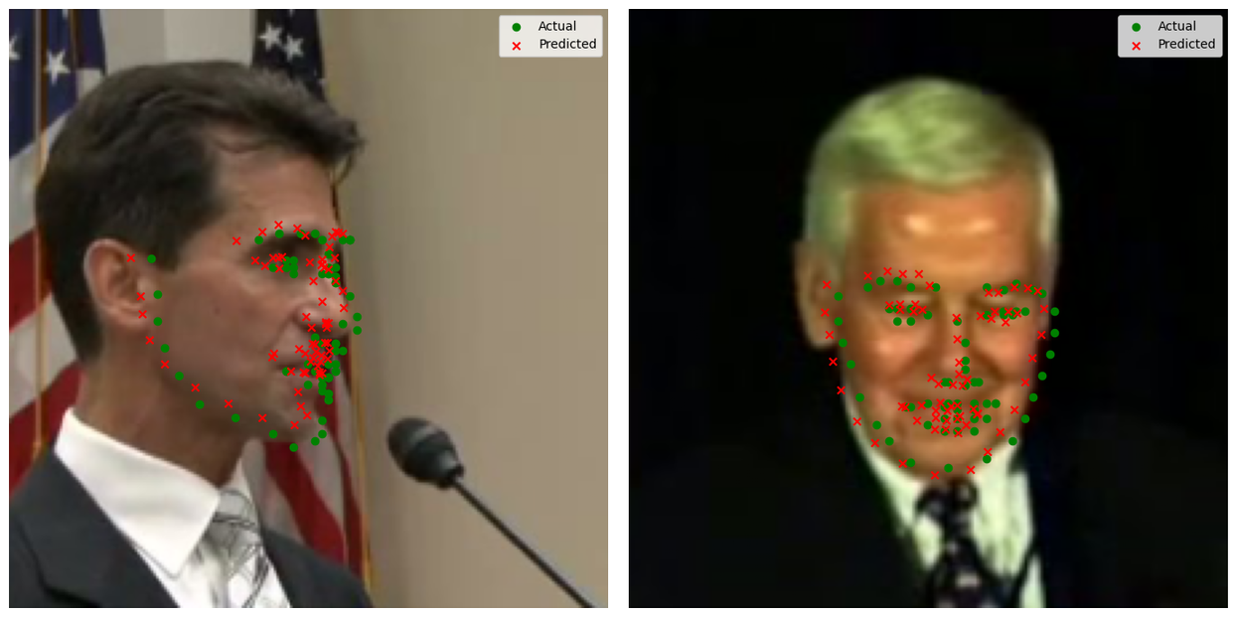
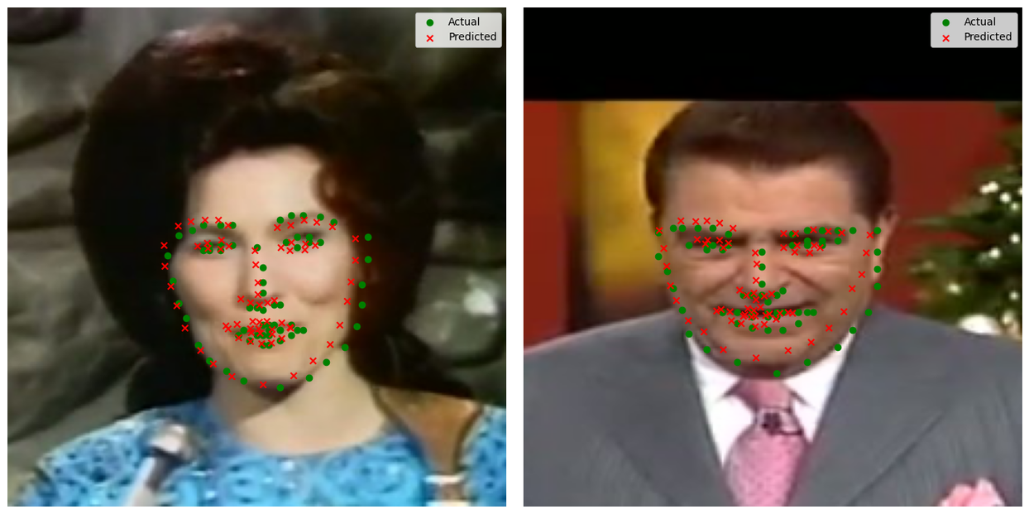
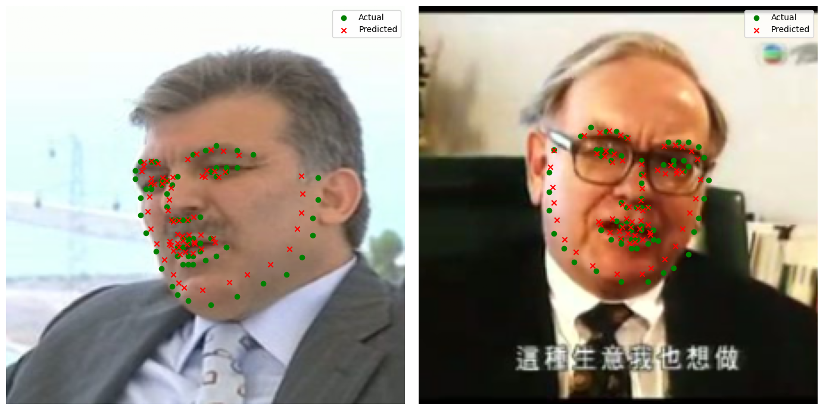
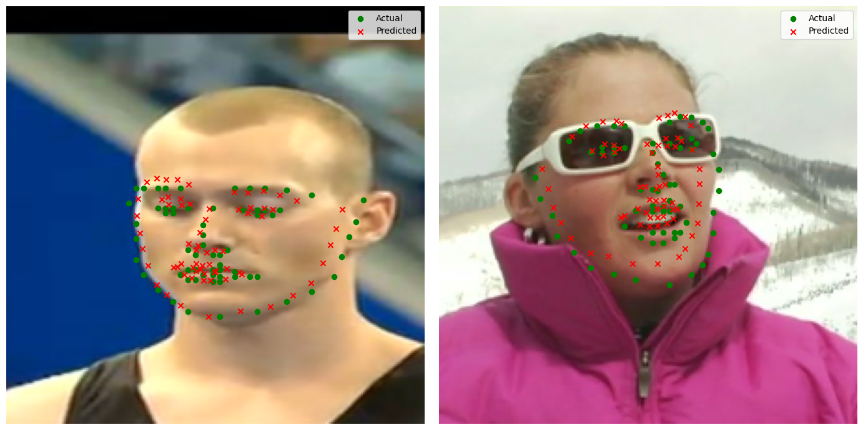

Slide 22
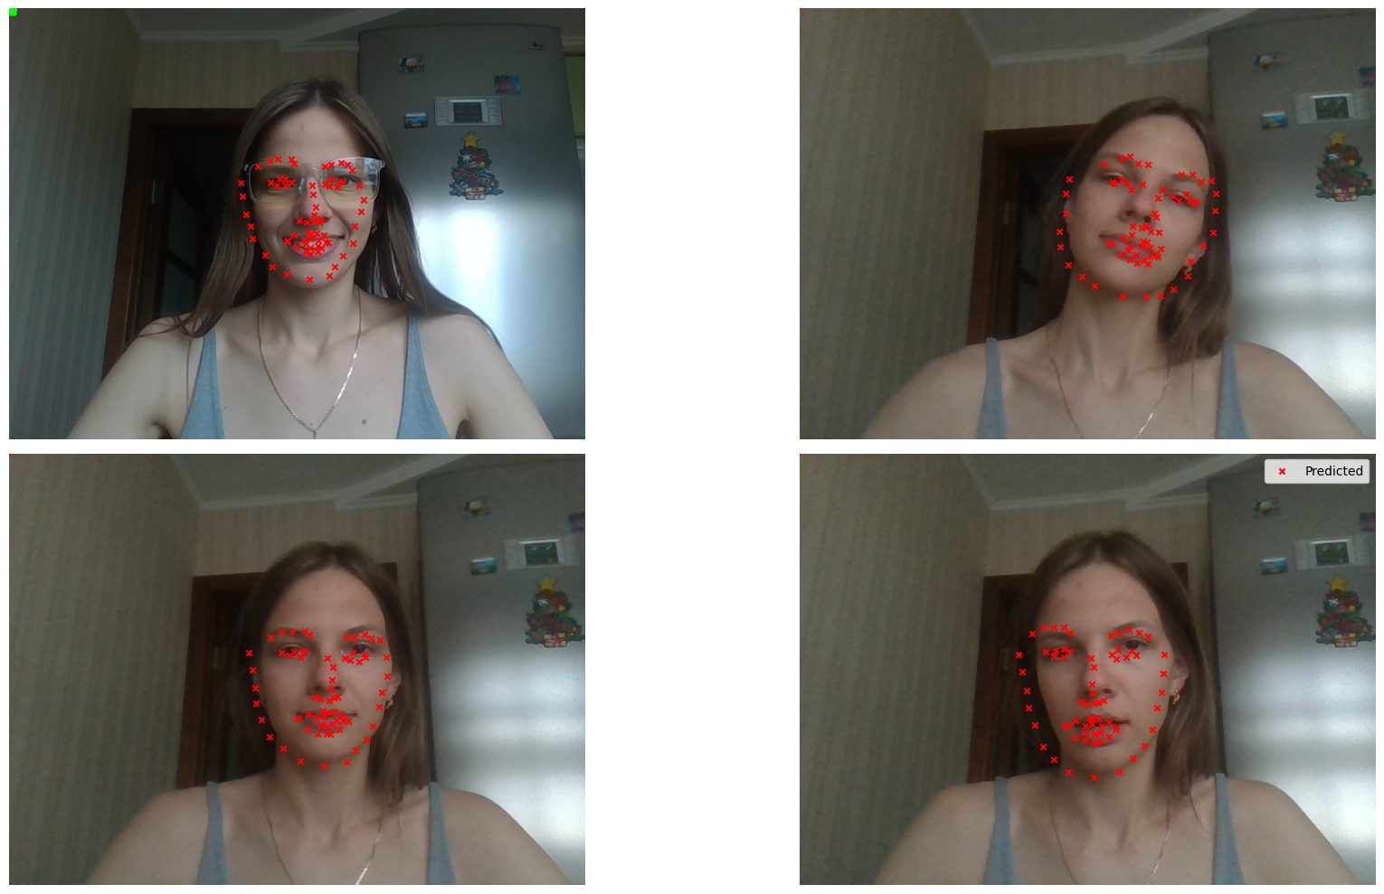

Slide 23
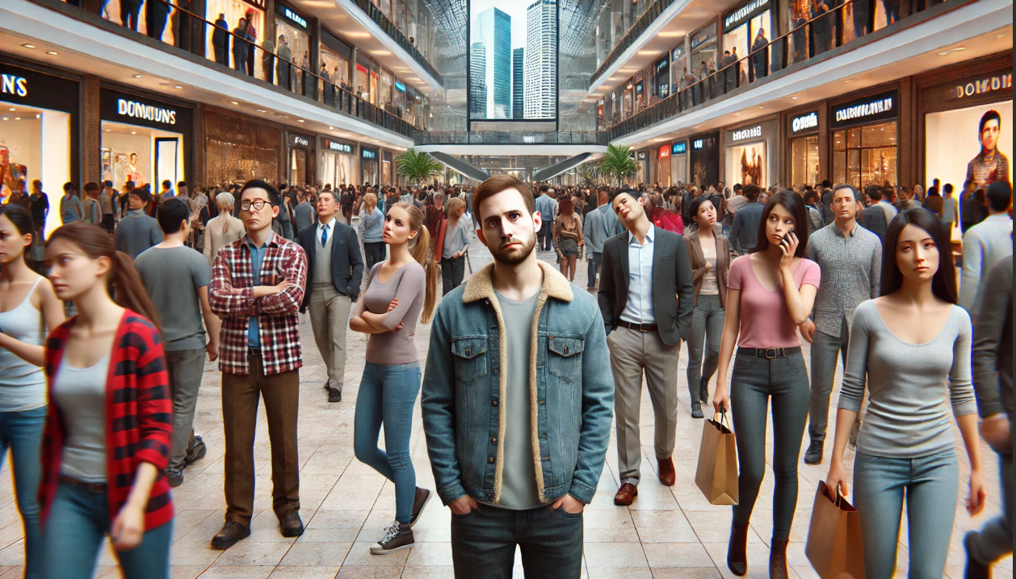
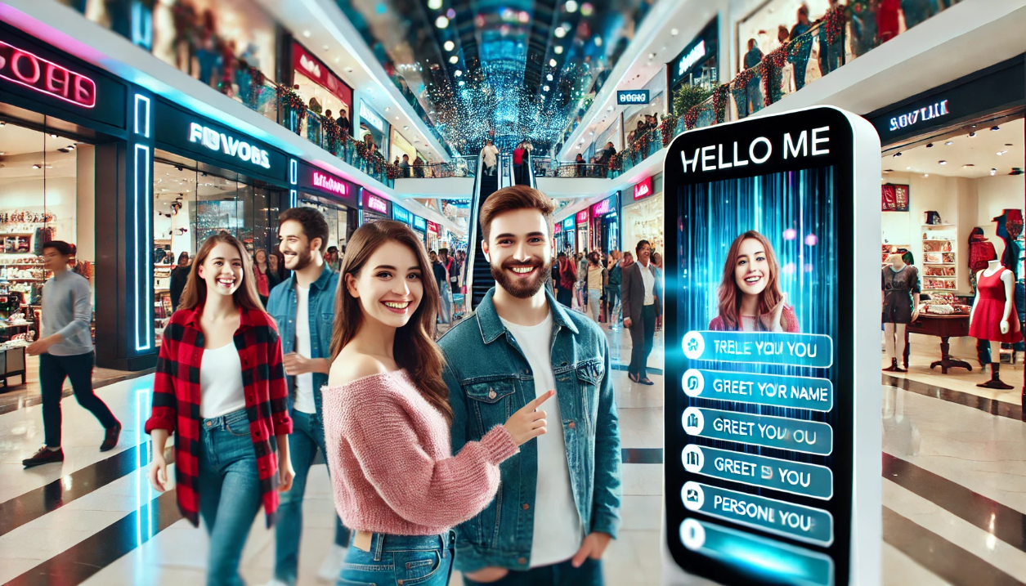
BEFORE
AFTER

Slide 24
THANK YOU!
KSENIYA KUDZELICH

